Slide 1




ADACTA ADINSURE
Analyst awards
and recognition
FEBRUARY 2025

Slide 2
Adacta.
One of the most innovative insurance software vendors in EMEA
HQ in Amsterdam with strong operations across Adriatic
AdInsure is an end-to-end solution for insurance teams
350 insurance and IT experts across 6 EMEA offices
Flagship product: the AdInsure insurance platform
Offices in Six Countries
Line and type of business agnostic platform for the insurance industry
AdInsure Solutions for Life, Non-Life, Commercial Insurers and Commercial Brokers.
End-to-end coverage of insurance processes, from sales to reinsurance
Trusted by a growing list of Insurance Clients
Recognized by leading market analysts
30+ projects across 9 countries
20 Non-life insurers
11 life insurers
2 Brokers
Featured in the Gartner MQ for Non-Life insurance platforms in EMEA
Winner of the XCelent award for the most advanced technology for life PAS systems in 2021
Notes:
We should change the order of the 4 squares:
1- AdInsure is
2 – Trusted
3 – recognized

Slide 3

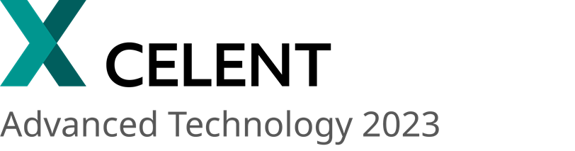


MARKET ANALYST COVERAGE
Adacta's AdInsure is recognized and awarded by top industry analysts
Gartner Magic Quadrant 2019-2021
Gartner® Market Guide for Non-Life Insurance Core Platforms, Europe, 2023-2025
Market Guide for Life Policy Administration Systems, EMEA, 2024-2025
XCelent Advanced Technology award for PAS Systems in EMEA Life Insurers 2021, 2023
Recognised as Advanced Technology in Celent's P&C Policy Administration reports for EMEA and LATAM, 2025
P&C Claims System vendors, EMEA and LATAM 2024
“Leader” in ISG’s Provider Lens™ for Insurance Platform Solutions 2023, 2024 for Life and Non-Life
Low code technology Providers in Insurance- Products PEAK Matrix® Assessment 2023

Slide 4
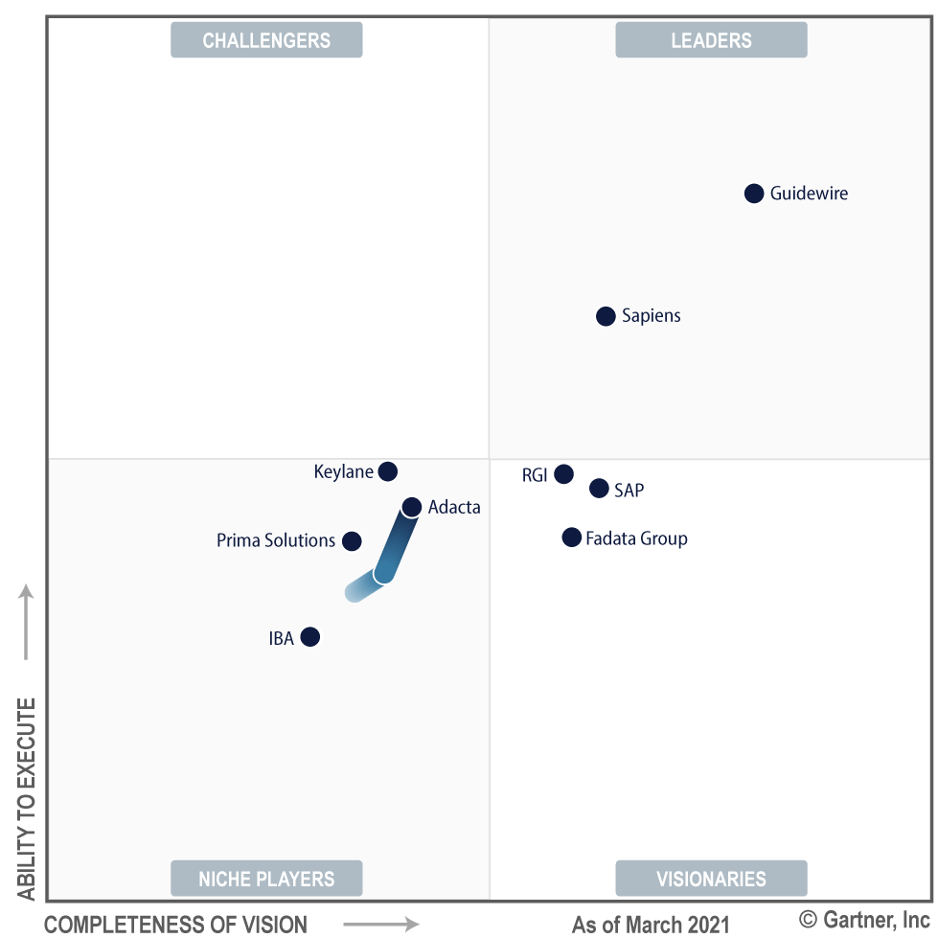
GARTNER'S PERSPECTIVE
Gartner debuted Adacta in their Non-Life Magic Q. in 2019
From 2019 to 2021, Adacta steadily advanced its standing in the Gartner Magic Quadrant.
In 2022, Gartner transitioned to a Market Guide, with Adacta still highlighted among the featured vendors in 2022, 2023, 2025 and 2025.
This recognition validates Adacta's position as a premier partner for tier-1 and tier-2 insurers. It also endorses Adacta’s strategic vision, technological advantages, expansion across international markets, and growing support for new lines of insurance business.
Image: Adapted from Gartner Magic Quadrant for Non-life insurance platforms, Europe 2019, 2020, and 2021

Slide 5



GARTNER'S PERSPECTIVE
Gartner about AdInsure
Configuration flexibility
Fits all sizes of insurers
Well rounded
features
“AdInsure Studio, a UI-based tool for configuration of the majority of existing platform capabilities significantly improves the degree of self-service for the business users”
“Also proven for some of the largest insurance companies in Eastern Europe.“
"Attractive out-of-the-box pre-integrated platform capabilities that accelerate and ease implementations for insurers."

Slide 6
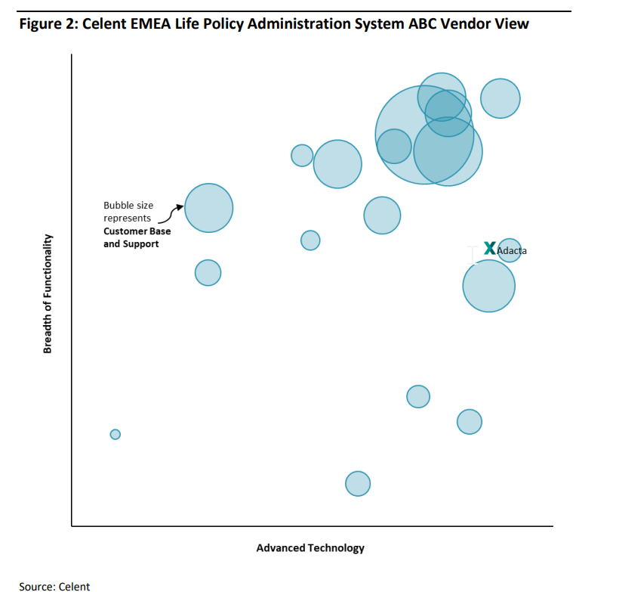
CELENT'S PERSPECTIVE
Adacta secures xCelent award for Life PAS, EMEA in 2021 and 2023
For two consecutive terms, Adacta secured the esteemed biennial XCelent Award in the category of Advanced Technology
The recognition highlights AdInsure as a standout innovative Life System within the industry.
The assessment comprises evaluations from both Celent and customers, taking into account customer feedback regarding technology, integration, APIs, deployment choices, change facilitation, and upgrade automation.

Slide 7
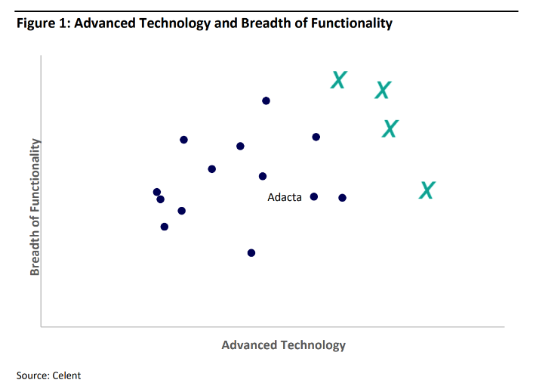
CELENT'S PERSPECTIVE
Adacta featured in Celent Non-Life reports in 2021 2023, 2024, 2025
EMEA and LATAM Property Casualty claims administration reports 2023, 2024, 2025 feature Adacta’s AdInsure Property & Casualty Claims as a comprehensive solution with a user-friendly interface, Google Maps integration, and customization options.
P&C policy administration systems in EMEA, 2021, 2023 highlight Adacta's AdInsure as a leading choice, garnering consistent client praise and securing new deals continuously

Slide 8



CELENT'S PERSPECTIVE
Celent research highlights
Customizable Interfaces
Efficient Configuration
Effective Task Management
The system allows users to fully customize both internal and external interfaces, enhancing user engagement and navigation.
AdInsure Insurance Platform Life offers an easy-to-use configuration environment for setting up new products and interfaces, including Excel integration and pre-defined templates.
The system features an activity schedule and tasks plan with a visual Gantt chart, aiding in managing activities, meeting deadlines, and optimizing task completion.

Slide 9
CELENT'S PERSPECTIVE
CELENT about
AdInsure
Adacta's AdInsure Insurance Platform Life, profiled since 2018, offers customizable interfaces, product configuration via AdInsure Studio, and task management with activity schedules. The system is modern and continuously advancing, despite some pending life product support. Adacta's investments show promise for future growth in Europe.
- CELENT, 2023

Slide 10
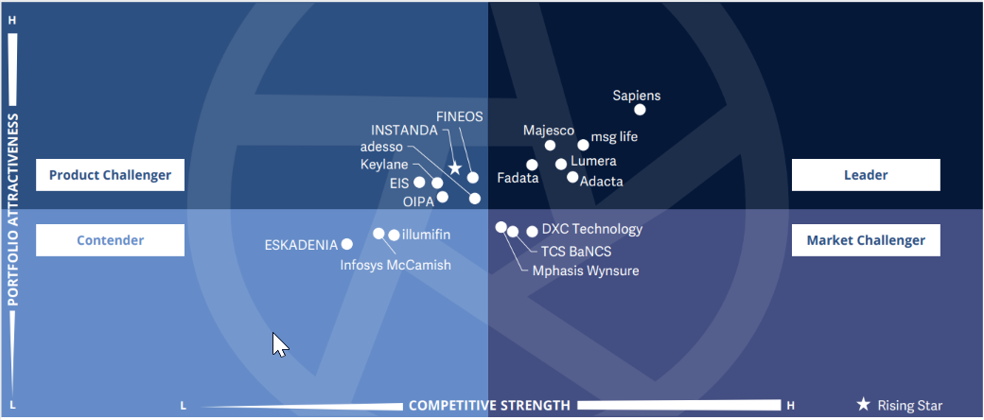
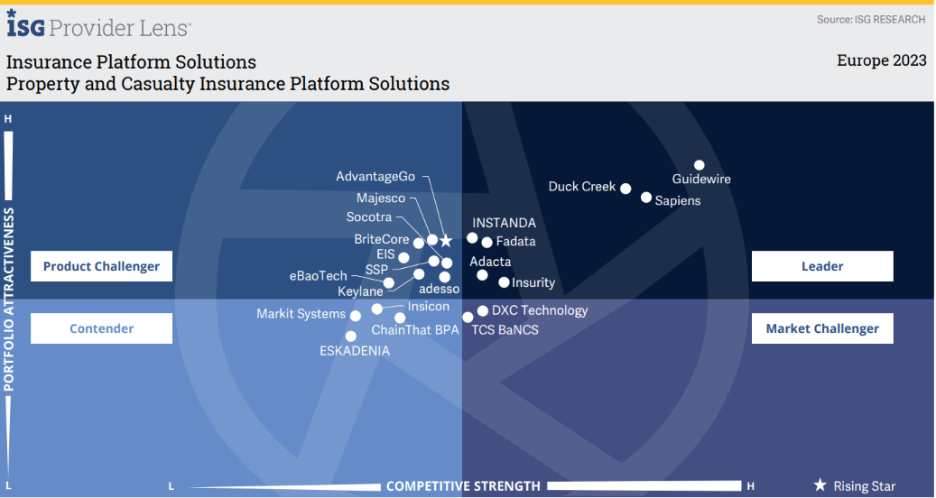
ISG'S PERSPECTIVE
Adacta identified as
a “Leader” in ISG’s Provider Lens™ report
The 2023 and 2024 ISG Provider Lens™ report evaluated top European insurance platform solution providers for Life & Retirement and Property & Casualty.
Adacta has been identified as a leader in both categories, along with only two other companies.
Adacta excelled in versatile products, digital capabilities, end-to-end insurance functions, a strong customer base, and exceptional support services.

Slide 11
ISG'S PERSPECTIVE
ISG named Adacta
a "Leader" in their 2024 Provider Lens™ report for Life
ISG praised Adacta's AdInsure platform for being standardized, adaptable, cloud-ready, and capable of quickly implementing changes.
Adacta's AdInsure platform fosters innovation through personalized customer experiences and adaptable product development, according to ISG.

Slide 12



ISG'S PERSPECTIVE
ISG Life research highlights
Standardized yet adaptable
Quick implementation of changes
Cloud-ready platform
AdInsure Life offers insurers modern, adaptable capabilities based on industry best practices. Easily customizable modules provide a seamless upgrade path to meet specific requirements.
AdInsure Life allows insurers to make hassle-free modifications without affecting the source code. This empowers insurers to improve their processes independently, saving costs and eliminating the need for vendor assistance.
With AdInsure Life, insurers efficiently manage products and migrate to the cloud. It works in private or Microsoft Azure's public cloud, connecting insurers with trusted partners for a complete insurance solution, including AdInsure platform and Microsoft Dynamics CRM, NAV, and BI tools.

Slide 13

ISG'S PERSPECTIVES
ISG about
AdInsure Life
“Adacta has a clear vision of its roadmap for its AdInsure Life platform. It offers a great blend of Business and technological capabilities insurers require to reinvent and alter their journeys.”
-Ashish Jhajharia, Co-Head of EMEA, ISG

Slide 14
ISG'S PERSPECTIVE
ISG named Adacta a "Leader" in their 2024 Provider Lens™ report for P&C
ISG recognizes Adacta's AdInsure platform as a robust solution for Non-Life insurance, offering productivity tools for P&C teams, a digital-first user experience, and comprehensive coverage.
Adacta's AdInsure platform enables insurers to digitize products and distribution channels, revamp underwriting and claims processes, and minimize compliance risks according to ISG.

Slide 15



ISG'S PERSPECTIVE
ISG P&C research highlights
Comprehensive
nonlife insurance coverage
Productivity tools for all P&C teams
Digital-first user experience
Adacta's AdInsure digitizes P&C insurance for individuals and businesses. It offers predefined yet customizable insurance products using AdInsure Studio. Insurers can create and launch new products and portals, saving costs and supporting growth.
AdInsure offers a complete set of business capabilities designed for all teams of a P&C insurer, including sales, underwriting, policy management, claims, accounting, and reinsurance.
AdInsure offers tailored agent workspace, full P&C claims support, quick new product creation, and seamless change management. It also includes advanced BI capabilities for handling financial commitments.

Slide 16
ISG'S PERSPECTIVES
ISG about
AdInsure P&C
“Adacta’s AdInsure enables insurers to digitize their products and distribution channels, rethink and redesign their underwritings and claim processes, and reduce compliance risks.”
-Ashish Jhajharia, Co-Head of EMEA, ISG

Slide 17
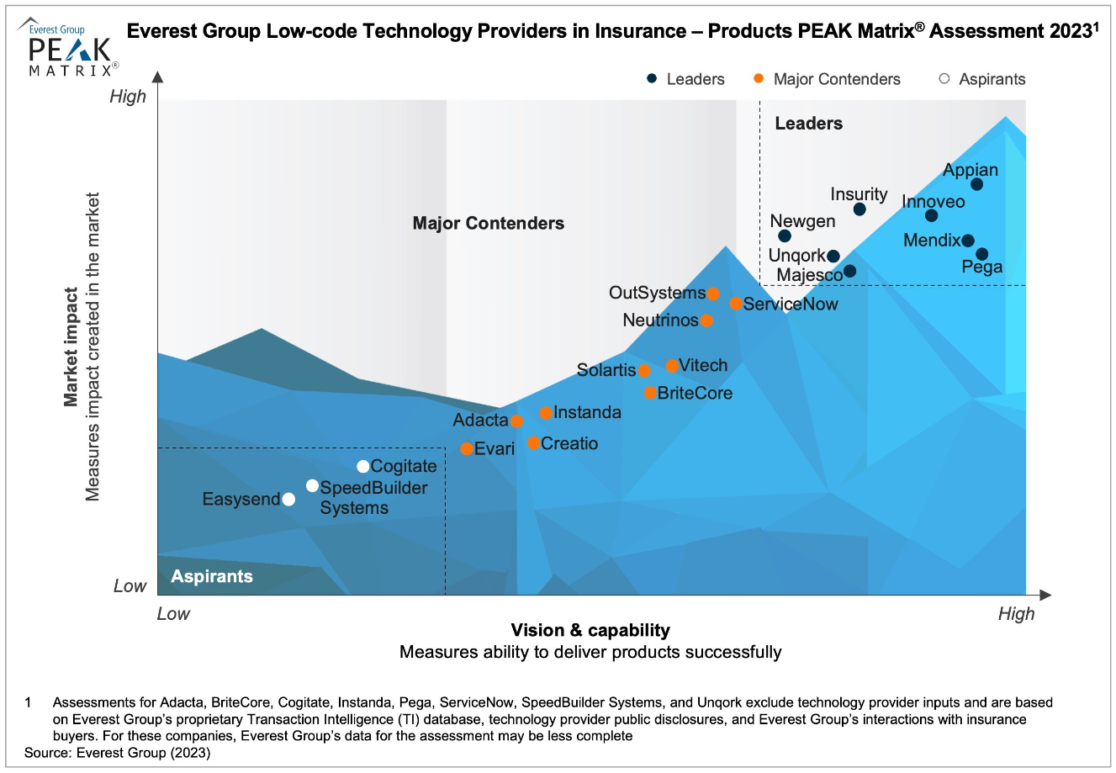
EVEREST'S PERSPECTIVE
Everest Group features Adacta in their global low-code PEAK Matrix 2023
Adacta is positioned as a Major Contenders among 21 Low-Code Technology Providers in Insurance globally
Adacta is the only European Core platform provider featured in the report
Adacta's dedication to low-code innovation positions the company as a major player in modernizing insurance.

Slide 18
Content: Adapted and based on industry reports.
COMPETITIVE DIFFERENTIATION
AdInsure’s strengths based on
leading industry research and analyst
companies
Highly configurable with low code support
Product support is predefined yet extendable. Insurers may use AdInsure Studio to create, test, and launch new products and customized portals for their teams (sales and claims, among others).
Adacta has transitioned all clients to its GUI-based tool for the configuration of the majority of existing platform capabilities, including products, processes, and portals, plus environment and configuration management. A graphical editor significantly improves the degree of self-service for the business users of AdInsure, with additional tooling for technical users to complete the remainder of the configuration using JSON schemas.
Digital-first user-experience
AdInsure delivers a customized, user-friendly agent workplace with end-to-end support for P&C insurance claims, rapid creation of new products and change management.
Productivity tools for all P&C teams: AdInsure offers a complete set of business capabilities designed for all teams of a P&C insurer, including sales, underwriting, policy management, claims, accounting and reinsurance.
Wide regional market presence
Adacta relies on direct sales for its target markets and works with channel partners in countries where it does not have a direct presence. This has helped the vendor to achieve production deployment in eight European countries, significantly higher than the market average. Insurance CIOs in Eastern European countries will find the vendor more accessible than others covered in this report.
Comprehensive out-of-the box feature set
AdInsure offers attractive out-of-the-box integrated platform capabilities that accelerate and ease implementations for insurers. These include portal solutions and integrations with BI and CRM.
AdInsure enables insurers to digitize a wide range of P&C insurance lines for individual and commercial clients. It supports all the existing and future commercial P&C lines.
It facilitates handling financial commitments by incorporating extensive BI capability embedded directly into AdInsure.
It provides considerable savings (infrastructure, knowledge, and maintenance) and supports future growth plans.
Scalable for even the larger insurers
Adacta’s AdInsure platform is proven for some of the largest non-life-insurance companies in Eastern Europe. Ten percent of production deployments support more than 1,000 users, and the vendor has clients with more than €2 billion in gross written premiums in production.
High level of client satisfaction
The vendor’s clients have been very positive about their experience in dealing with Adacta. The vendor received the highest score among Magic Quadrant vendors for ease of doing business and maintenance/support services. European non-life-insurance CIOs should place additional value on service in a market where implementation and maintenance can be challenging.
Seamless integration and API capabilities
AdInsure exposes 100% of its functionality through RESTful API calls for out-of-the-box features, covering all core modules — policy, billing and claims. An out-of-the-box integration framework is also offered for insurance CIOs to simplify integrations with external systems and partners.

Slide 19
Contact us
Book a demo
info@adacta-fintech.com
Take AdInsure for a spin
This presentation is the property of Adacta and its subsidiaries (the “Company”) and is strictly confidential. It contains information intended only for the person to whom it is transmitted. With receipt of this information, recipient acknowledges and agrees that: (i) this document is not intended to be distributed, and if distributed inadvertently, will be returned to the Company as soon as possible; (ii) the recipient will not copy, fax, reproduce, divulge, or distribute this confidential information, in whole or in part, without the express written consent of the Company; (iii) all of the information herein will be treated as confidential material with no less care than that afforded to its own confidential material.
Adacta® All rights reserved.

